Slide 1
System Performance and Highly Concurrent Systems (2)
Lecture 13
Hartmut Kaiser
https://teaching.hkaiser.org/spring2026/csc4103/

Slide 2
Goals for Today
Finish up discussion of highly concurrent systems
Start exploring OS memory management (if time permits)

Slide 3
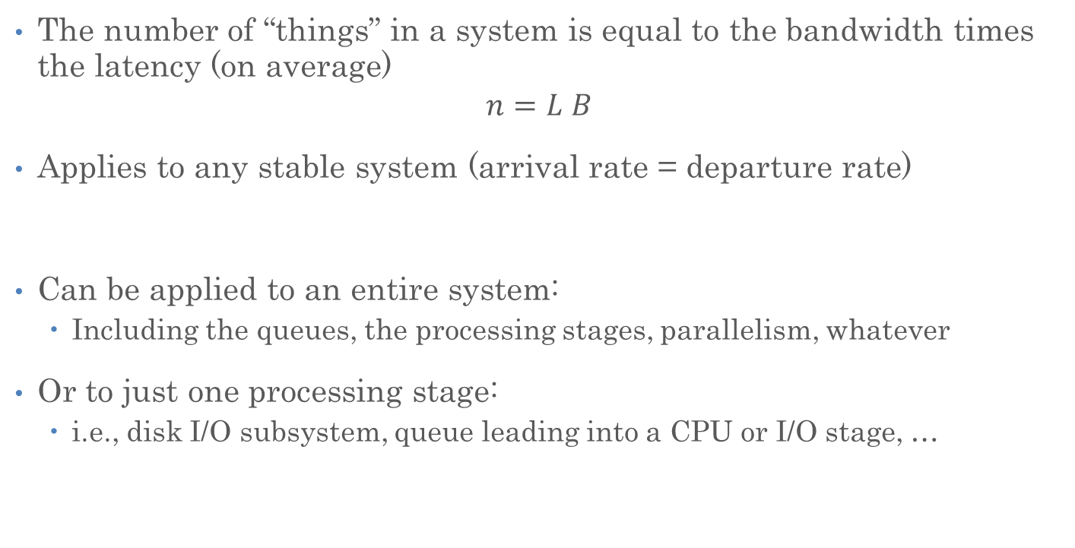
Recall: Little’s Law
The number of “things” in a system is equal to the bandwidth times the latency (on average)
$$n=L B$$
Applies to any stable system (arrival rate = departure rate)
Can be applied to an entire system:
  Including the queues, the processing stages, parallelism, whatever
Or to just one processing stage:
  i.e., disk I/O subsystem, queue leading into a CPU or I/O stage, …

Slide 4
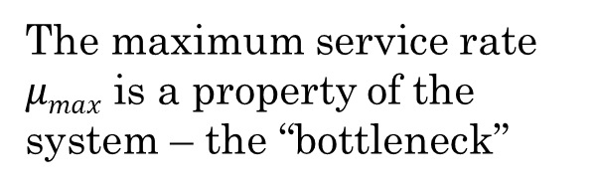





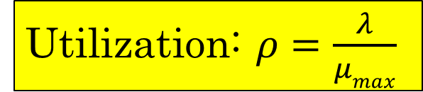
Recall: A Simple System Performance Model
Request Rate: $λ$
Latency ($L$)
Queuing delay: $d$
Operation Time: $t$
The maximum service rate $μmax$ is a property of the system – the “bottleneck”
Utilization: $ρ=\frac{λ}{μmax}$
Service Rate: $μ$

Slide 5



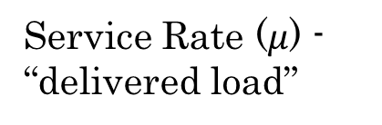
Recall: Ideal System Performance
How does $μ$ (service rate) vary with $λ$ (request rate)?
asymptotic peak rate
$$μmax$$
Service Rate ($μ$) - “delivered load”
$$μmax$$
Request Rate ($λ$ ) - “offered load”

Slide 6


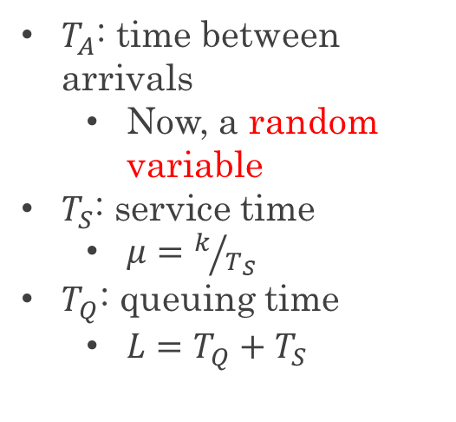
Recall: A Bursty World
Requests arrive in a burst, must queue up until served
Same average arrival time, but almost all of the requests experience large queue delays (even though average utilization is low)
$T_{A}$: time between arrivals
  Now, a random variable
$T_{S}$: service time
  $μ=k/{T_{S}}$
$T_{Q}$: queuing time
  $L=T_{Q}+T_{S}$
arrivals
Queue
Server
departures
$$T_{Q}$$
$$T_{S}$$
Arrivals
Q depth
Server

Slide 7


Recall: Little’s Law Applied to a Queue
Before, we had $n=LB$ (for a stable system):
  $B$: bandwidth
  $L$: latency
  $n$: number of operations in the system
When applied to a queue, we get:
Average Arrival Rate
$$L_{Q}=λT_{Q}$$
Average length of the queue
Average time “waiting”

Slide 8
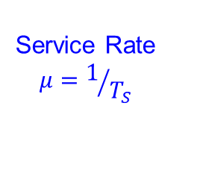

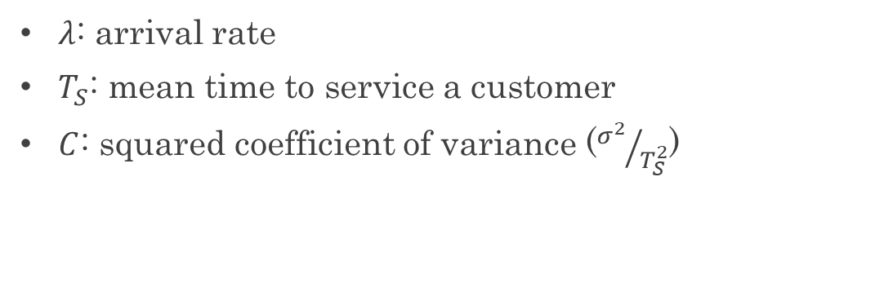
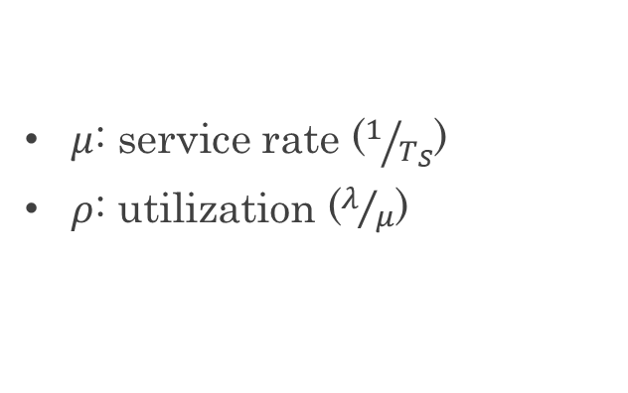
Recall: Some Results from Queuing Theory
Assumptions: system in equilibrium, no limit to the queue, time between successive arrivals is random and memoryless
Queue
Server
Arrival Rate
$$λ$$
Service Rate
$$μ=1/{T_{S}}$$
$λ$: arrival rate
$T_{S}$: mean time to service a customer
$C$: squared coefficient of variance (${σ^{2}}/{T_{S}^{2}}$)
$μ$: service rate ($1/{T_{S}}$)
$ρ$: utilization ($λ/μ$)

Slide 9

Recall: Some Results from Queuing Theory
Memoryless service distribution ($C=1)$ - an “M/M/1 queue”:
  $$T_{Q}=\frac{ρ}{1−ρ}⋅T_{S}$$
General service distribution (no restrictions) - an “M/G/1 queue”:
  $$T_{Q}=\frac{1+C}{2}⋅\frac{ρ}{1−ρ}⋅T_{S}$$
$λ$: arrival rate
$T_{S}$: mean time to service a customer
$C$: squared coefficient of variance (${σ^{2}}/{T_{S}^{2}}$)
$μ$: service rate ($1/{T_{S}}$)
$ρ$: utilization ($λ/μ$)

Slide 10
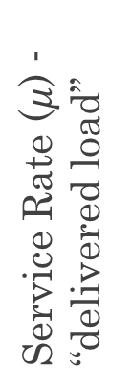
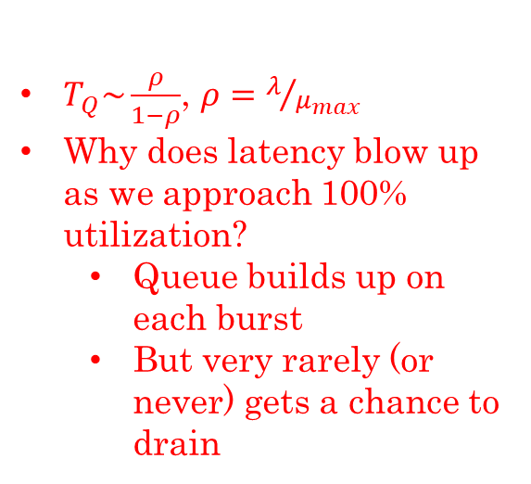




Recall: Ideal System Performance
$T_{Q}\sim \frac{ρ}{1−ρ}$, $ρ=λ/{μ_{max}}$
Why does latency blow up as we approach 100% utilization?
  Queue builds up on each burst
  But very rarely (or never) gets a chance to drain
Latency ($λ$)
Service Rate ($μ$) - “delivered load”
Time
$$μmax$$
Operation Time
$$μmax$$
Request Rate ($λ$ ) - “offered load”
“Half-Power Point”: load at which system delivers half of peak performance
Design and provision systems to operate roughly in this regime
Latency low and predictable, utilization good: ~50%

Slide 11




Do real systems really hit a wall as utilization approaches 100%?
$$μmax$$
server
Open System
$$λ$$
clients
$$μmax$$
server
$$λ$$
Closed System
clients

Slide 12
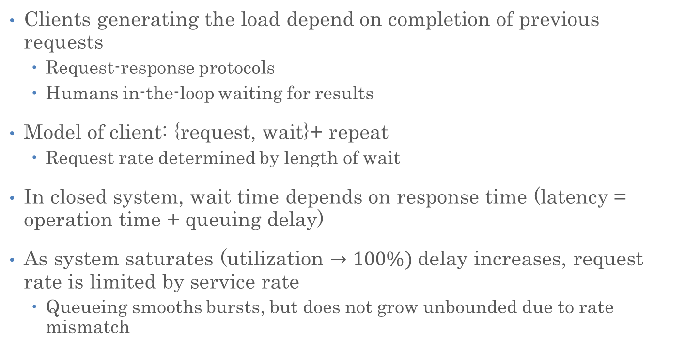
Closed System
Clients generating the load depend on completion of previous requests
  Request-response protocols
  Humans in-the-loop waiting for results
Model of client: {request, wait}+ repeat
  Request rate determined by length of wait
In closed system, wait time depends on response time (latency = operation time + queuing delay)
As system saturates (utilization $→100\%)$delay increases, request rate is limited by service rate
  Queueing smooths bursts, but does not grow unbounded due to rate mismatch

Slide 13
What Causes Systems to Close?
Protocols are designed to have self-limited behavior
  Request-response, bounded number of outstanding requests per client
Underlying system induces “back pressure” even if higher level services and applications don’t
  Bounded size queues (not just because of memory size)
  What happens when it fills up?

Slide 14
Queuing Theory Resources
Queuing theory resources are available on the “Resources” section of the course website

Slide 15
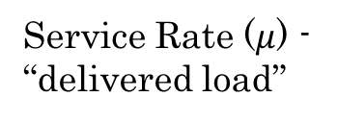



Recall: Well-Conditioned Systems
A system that behaves this way is well-conditioned
  Delivered load increases with offered load until pipeline saturates
  As offered load increases further, throughput remains high
asymptotic peak rate
$$μmax$$
Service Rate ($μ$) - “delivered load”
$$μmax$$
Request Rate ($λ$ ) - “offered load”

Slide 16
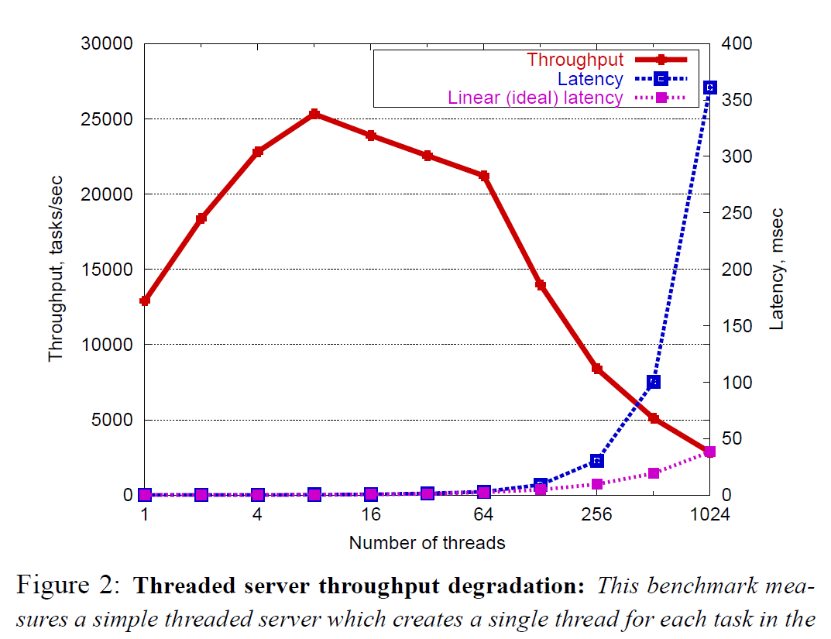
Recall: Non-Well-Conditioned Systems
A server that spawns a new pthread per request is not well-conditioned!
Figure from SEDA Section 2 reading (Welsh 2001)

Slide 17
Building Well-Conditioned Systems
Spawning a new thread or process for each request is not well-conditioned
Too many threads is bad
  Scheduling overhead becomes large
  Context switch overhead becomes large
    E.g., Poor cache performance
  Synchronization overhead becomes large
    E.g., Lock contention
Was our original (v1) server well-conditioned?
  The one that handles requests one at a time, with no concurrency?

Slide 18
System Performance and Highly Concurrent Systems
Part 2

Slide 19
Concurrent, Well-Conditioned Systems
Thread Pools
User-Mode Threads
Event-Driven Execution

Slide 20
Thread Pools
Key idea: limit the number of threads
  Before throughput starts to degrade
Instead, allocate a bounded “pool” of worker threads, representing the maximum level of multiprogramming
Master
Thread
queue
Thread Pool

Slide 21
Thread Pools
master() {
allocThreads(worker, queue);
while(TRUE) {
con = AcceptCon();
// Blocks if full
Enqueue(queue, con);
}
}
worker(queue) {
while(TRUE) {
// Blocks if empty
con = Dequeue(queue);
ServiceWebPage(con);
}
}
Master
Thread
queue
Thread Pool

Slide 22
We’ve Looked At: Kernel-Supported Threads
Thread pools work well, but they somewhat limit concurrency
  Why?
  Threads run and block (e.g., on I/O) independently
  One process may have multiple threads waiting on different things
  Two mode switches for every context switch (expensive)
  Create threads with syscalls
Is there a good alternative?
  Multiplex several streams of execution (at user level) on top of a single OS thread
  E.g., Java, Go, … (and many many user-level threads libraries before it)

Slide 23
Concurrent, Well-Conditioned Systems
Thread Pools
User-Mode Threads
Event-Driven Execution

Slide 24
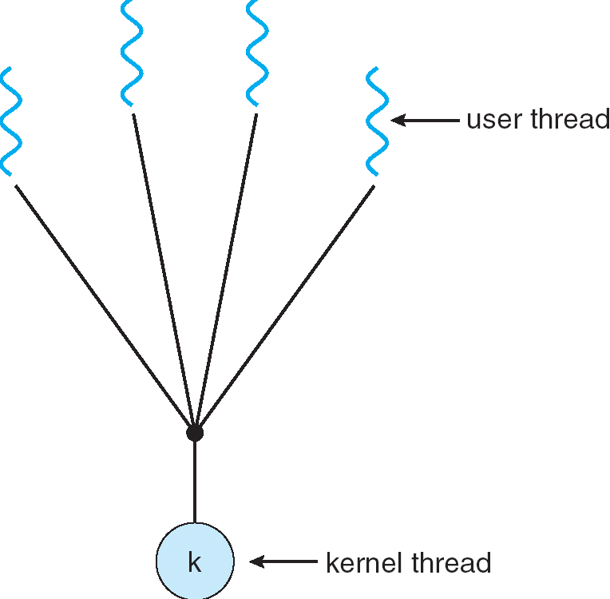
User-Mode Threads
User program contains its own
scheduler
Several user threads per kernel thread
User threads may be scheduled
non-preemptively
  Only switch on yield
Context switches cheaper
  Copy registers and jump (switch in userspace)

Slide 25
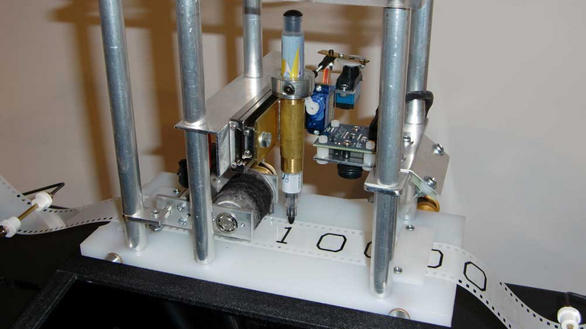
Recall: What’s a ‘Thread’?
An entity which exposes 4 properties:
  A single flow of control (sequence of op-codes)
  A program counter marking what’s currently being executed
  An associated execution context (stack, register set, static and dynamic memory, thread local variables, etc.)
  A state (initialized, pending, suspended, terminated, etc.)

Slide 26
Thread Yield
Kernel-Supported Threads
User-Mode Threads
ComputePI
ComputePI
yield (syscall)
Library Function
Call (Cheap)
yield
Trap to OS
(Expensive)
kernel_yield
Stack growth
run_new_user_
thread
Stack growth
run_new_kernel_
thread
switch
switch

Slide 27
User-Mode Threads: Problems
One user-level thread blocks on I/O: they all do
  Kernel cannot adjust scheduling among threads it doesn’t know about
Multiple Cores?
  Need mechanisms like work-stealing
Can’t completely avoid blocking (syscalls, page fault)
One Solution: Scheduler Activations
  Have kernel inform user-level scheduler when a thread blocks
  Evolving the contract between OS and application
  Not all OS support this (actually close to none)
Alternative Solution: Language Support?
  Make the scheduler aware of the blocking operation

Slide 28
Thread I/O
Kernel-Supported Threads
User-Mode Threads
CopyFile
CopyFile
read
read
Trap to OS
Trap to OS
kernel_read
Stack growth
kernel_read
Stack growth
run_new_thread
run_new_thread
switch
switch
Selects a new kernel thread to run
Bypassing user-level scheduler

Slide 29
Library Solutions: Example
HPX – A C++ Asynchronous Many-task Runtime System
  A library linking to your application
At it’s heart, HPX is a very efficient (user-level) threading implementation
Several functional layers are implemented on top:
  C++ standards-conforming API exposing everything related to parallelism and concurrency
  Full set of C++17/C++20/C++23 (parallel) algorithms
  Full set of senders/receivers (currently being discussed for standardization)
    Implemented using C++17
  Distributed operation
    Extending the standard interfaces for use on tightly coupled clusters (super-computers)
    Global address space, load balancing, uniform API for local and remote operations

Slide 30
Go Goroutines
Goroutines are lightweight, user-level threads
  Scheduling not preemptive (relies on goroutines to yield)
  Yield statements inserted by compiler
Advantages relative to regular threads (e.g., pthreads)
  More lightweight
  Faster context-switch time
Disadvantages
  Less sophisticated scheduling at the user-level
  OS is not aware of user-level threads

Slide 31
Go User-Level Scheduler
Why this approach?
1 OS (kernel-supported) thread per CPU core: allows Go program to achieve parallelism not just concurrency
  Fewer OS threads? Not utilizing all CPUs
  More OS threads? No additional benefit
    We’ll see one exception to this involving syscalls
Keep each (kernel-supported) bound to a core
Keep goroutine on same OS thread: affinity, nice for caching and performance

Slide 32
Go User-Level Thread Scheduler
Why not just have a single global run queue?
Global Run Queue
Newly created goroutines
Local Run Queue
Local Run Queue
Local Run Queue
OS Thread (M)
OS Thread (M)
OS Thread (M)
…
CPU Core
CPU Core
CPU Core

Slide 33
Dealing with Blocking Syscalls
Local Run Queue
What if a goroutine wants to make a blocking syscall?
  Example: File I/O
Running Go-rtn.
OS Thread (M1)
CPU Core

Slide 34
Dealing with Blocking Syscalls
Local Run Queue
What if a goroutine wants to make a blocking syscall?
  Example: File I/O
While syscall is blocking, allocate new OS thread (M2)
  M1 is blocked by kernel, M2 lets us continue using CPU
OS Thread (M2)
Blocking Go-rtn.
CPU Core
OS Thread
(M1)

Slide 35
Dealing with Blocking Syscalls
Local Run Queue
Syscall completes: Put invoking goroutine back on queue
Keep M1 around in a spare pool
Swap it with M2 upon next syscall, no need to pay thread creation cost
Running Go-rtn.
OS Thread (M2)
Ready Go-rtn.
CPU Core
OS Thread
(M1)

Slide 36
Recall: Motivation for Threads
Operating systems must handle multiple things at once (MTAO)
  Processes, interrupts, background system maintenance
Networked servers must handle MTAO
  Multiple connections handled simultaneously
Parallel programs must handle MTAO
  To achieve better performance
Programs with user interface often must handle MTAO
  To achieve user responsiveness while doing computation
Network and disk bound programs must handle MTAO
  To hide network/disk latency
  Sequence steps in access or communicatoin

Slide 37
Recall: Threads Allow Handling MTAO
Threads are a unit of concurrency provided by the OS
Each thread can represent one thing or one task

Slide 38
Announcements
Assignment 3 due April 27
  No deadline extensions will be possible
No time to schedule another project
  People are still asking for extensions
We will do a final examination after all
  May 6, 12.30pm-2.30pm
  I will adjust the grading scale to include this

Slide 39
Concurrent, Well-Conditioned Systems
Thread Pools
User-Mode Threads
Event-Driven Execution

Slide 40
Event-Driven Execution
Allows a system to handle MTAO with a single thread
  Very lightweight
Key idea: juggle different tasks within a single thread
  The thread is being scheduled by the OS
  All tasks’ CPU bursts execute within a single thread
  I/O bursts for each task happen in the background without an explicit backing thread – asynchronous I/O

Slide 41
Event-Driven Server Concept
  while (true) {
  int task_id = <wait for a task to become ready>
  <look up state for task_id>
  <execute next CPU burst for this task>
  if (task is done) {
  <forget state for task_id>
  continue;
  }
  <issue task’s next (I/O) operation>
  <update state for task_id>
  }

Slide 42
How to “Issue Task’s Next I/O Operation”?
So far, we’ve seen read and write, which block the calling thread
We can put file descriptors into non-blocking mode
  read: Just return whatever data is available
  write: Just write whatever the kernel can buffer in its memory for now
  So read/write calls may not read or write anything
How to wait for the next task to become ready to perform its I/O?

Slide 43
How to “Wait for Task to Become Ready”?
POSIX provides a way to wait for one of several file descriptors to have data available
  select/poll system calls
  Provide a list of file descriptors
  Blocks until at least one has “ready” data, then returns which ones do
  Mixes well with non-blocking I/O, especially sockets

Slide 44
Alternative Asynchronous I/O APIs
Unfortunately, non-blocking mode and select/poll don’t work well with regular files
Instead: there’s the asynchronous I/O interface
  io_submit issues a disk I/O
  io_getevents syscall reaps completion of disk I/Os issued with io_submit
Newer, better APIs still emerging (e.g., io_uring)

Slide 45
Event-Driven Server Concept
  while (true) {
  int task_id = <wait for a task to become ready>
  <look up state for task_id>
  <execute next CPU burst for this task>
  if (task is done) {
  <forget state for task_id>
  continue;
  }
  <issue task’s next (I/O) operation>
  <update state for task_id>
  }
This looks kind of like the OS thread scheduler…
But it runs in the user program!

Slide 46
User-Mode Scheduler Based on Event Loop
User-mode scheduler can be an event-loop
User threads use I/O library that issues async I/O operations
Now user-mode scheduler can properly suspend the thread…
But only works for I/O operations for which the kernel supports an asynchronous interface

Slide 47
User-Mode Scheduling vs. Event Loops
In user-mode scheduling:
  You’re still maintaining a separate stack for each thread
  Must save PC, stack, registers when switching
  Even if you use async I/O operations to properly suspend the user thread
In pure event-driven scheduling:
  All events execute in the same stack
  All state to resume each task (e.g., which stage we’re at) must be stored explicitly

Slide 48
Final Word on Scheduling
When do the details of the scheduling policy and fairness really matter?
  Performance! Efficiency! Utilization!
When should you simply buy a faster computer?
  One approach: Buy it when it will pay
  for itself in improved response time
    Perhaps you’re paying for worse response
    time in reduced productivity, customer angst, etc…
    Might think that you should buy a faster X
    when X is utilized 100%, but usually, response
    time goes to infinity as utilization⇒100%
An interesting implication of this curve:
  Most scheduling algorithms work fine in the “linear” portion of the load curve, fail otherwise
  Argues for buying a faster X when hit “knee” of curve
Response
time
100%
Utilization

Slide 49
