Slide 1
File Systems 1: Storage Devices and FAT
Lecture 16
Hartmut Kaiser
https://teaching.hkaiser.org/spring2026/csc4103/

Slide 2
What’s a Bus?
Common set of wires for communication among hardware devices plus protocols for carrying out data transfer transactions
Operations: e.g., Read, Write
Control lines, Address lines, Data lines
Protocol: initiator requests access, arbitration to grant, identification of recipient, handshake to convey address, length, data
Very high BW close to processor (wide, fast, and inflexible), low BW with high flexibility out in I/O subsystem

Slide 3
Typical PCI Architecture
RAM
Memory
Bus
CPU
Host Bridge
PCI #0
ISA Bridge
PCI Bridge
PCI #1
ISA Controller
PCI Slots
USB Controller
SATA Controller
Scanner
Legacy Devices
Root Hub
Hard Disk
DVD ROM
Hub
Webcam
PCI: Peripheral Component Interconnect
ISA: Industry Standard Architecture
SATA: Serial AT Attachment
Mouse
Keyboard

Slide 4
How does the Processor Talk to the Device?
Processor Memory Bus
Regular
Memory
CPU
CPU interacts with a Controller
Contains a set of registers that can be read and written
May contain memory for request queues, etc.
Processor accesses registers in two ways:
Port-Mapped I/O: in/out instructions
Example from the Intel architecture: out 0x21,AL
Memory-mapped I/O: load/store instructions
Registers/memory appear in physical address space
I/O accomplished with load and store instructions
Bus
Adaptor
Bus
Adaptor
Device
Controller
Address +
Data
Other Devices
or Buses
Bus
Interface
Hardware
Controller
Interrupt
Controller
Interrupt Request
read
Addressable
Memory
and/or
Queues
write
control
status
Registers
(port 0x20)
Memory Mapped
Region: 0x8f008020

Slide 5
Memory-Mapped Display Controller
0x80020000
Graphics
Command
Queue
Memory-Mapped:
Hardware maps control registers and display memory into physical address space
Addresses set by HW jumpers or at boot time
Simply writing to display memory (also called the “frame buffer”) changes image on screen
Addr: 0x8000F000 — 0x8000FFFF
Writing graphics description to cmd queue
Say enter a set of triangles describing some scene
Addr: 0x80010000 — 0x8001FFFF
Writing to the command register may cause on-board graphics hardware to do something
Say render the above scene
Addr: 0x0007F004
Can be protected with address translation
0x80010000
Display
Memory
0x8000F000
0x0007F004
Command
0x0007F000
Status
Physical
Address
Space

Slide 6
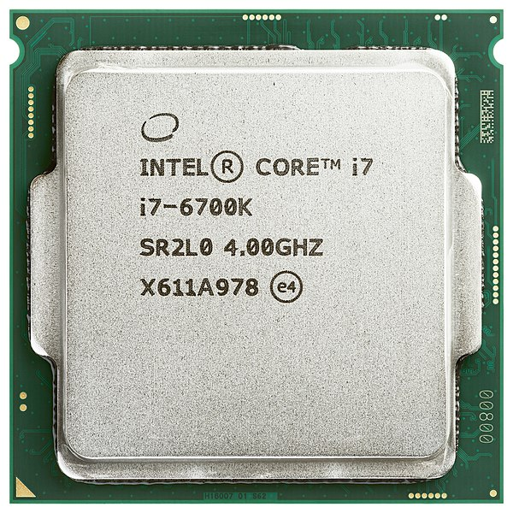
There’s more than just a CPU in there!

Slide 7
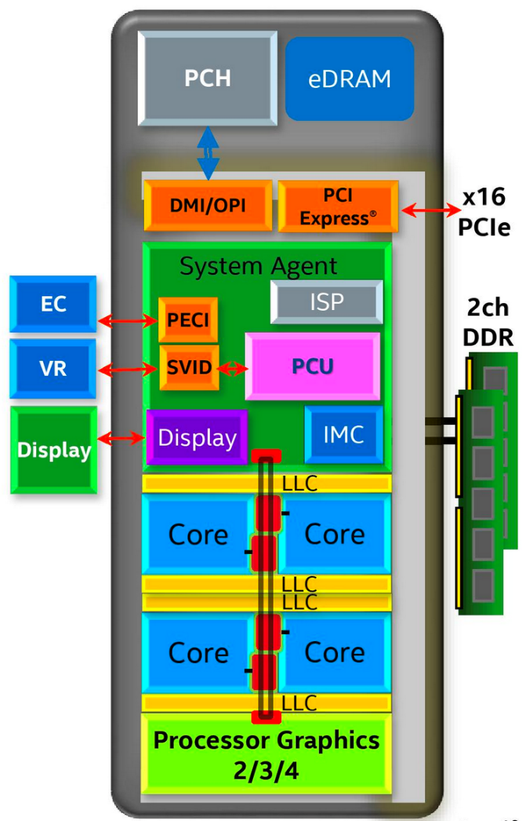
Chip-Scale Features of Skylake (x86 in 2015)
Significant pieces:
Four OOO (out-of-order) cores with deeper buffers
Integrated GPU, System Agent (Mem, Fast I/O)
Large shared L3 cache with on-chip ring bus
2 MB/core instead of 1.5 MB/core
High-BW access to L3 Cache
Integrated I/O
Integrated memory controller (IMC)
Two independent channels of DRAM
High-speed PCI-Express (for Graphics cards)
Direct Media Interface (DMI) Connection to PCH (Platform Control Hub)

Slide 8
Skylake I/O: Platform Controller Hub (PCH)
Platform Controller Hub
Connected to processor with proprietary bus
Direct Media Interface
Types of I/O on PCH:
USB, Ethernet
Thunderbolt 3
Audio, BIOS support
More PCI Express (lower speed than on Processor)
SATA (for Disks)
Sky Lake
System Configuration

Slide 9
Operational Parameters for I/O
Data granularity: Byte vs. Block
Some devices provide single byte at a time (e.g., keyboard)
Others provide whole blocks (e.g., disks, networks, etc.)
Access pattern: Sequential vs. Random
Some devices must be accessed sequentially (e.g., tape)
Others can be accessed “randomly” (e.g., disk, CD, etc.)
Fixed overhead to start transfers
Some devices require continual monitoring (polling)
Others generate interrupts when they need service
Transfer Mechanism: Programmed I/O and DMA

Slide 10
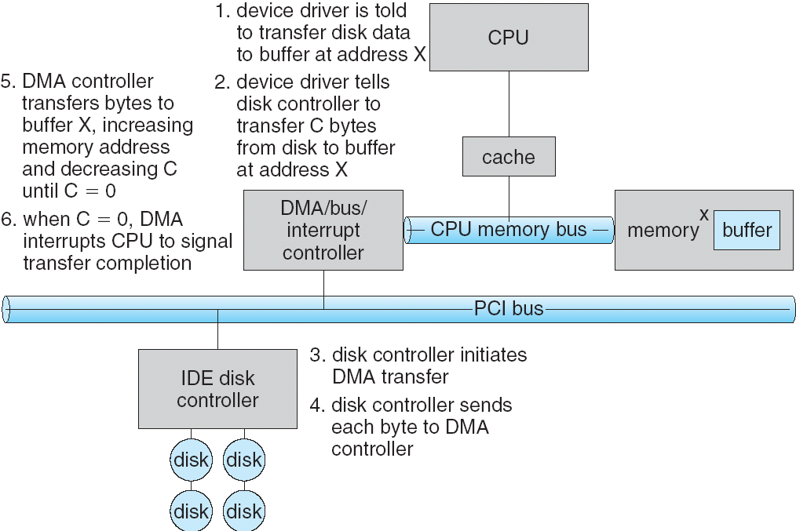
Transferring Data To/From Controller
Programmed I/O:
Each byte transferred via processor in/out or load/store
Pro: Simple hardware, easy to program
Con: Consumes processor cycles proportional to data size
Direct Memory Access:
Give controller access to memory bus
Ask it to transfer data blocks to/from memory directly
Interaction with DMA controller
1
2
3

Slide 11
Transferring Data To/From Controller
Programmed I/O:
Each byte transferred via processor in/out or load/store
Pro: Simple hardware, easy to program
Con: Consumes processor cycles proportional to data size
Direct Memory Access:
Give controller access to memory bus
Ask it to transfer data blocks to/from memory directly
Interaction with DMA controller
6
5
4

Slide 12
Aside: Linux Memory Details
Memory management in Linux considerably more complex than the examples we have been discussing
Memory Zones: physical memory categories
ZONE_DMA: < 16MB memory, DMA-able on ISA bus
ZONE_NORMAL: 16MB → 896MB (mapped at 0xC0000000)
ZONE_HIGHMEM: Everything else (> 896MB)
Each zone has 1 freelist, 2 LRU lists (Active/Inactive)
Many different types of allocations
SLAB allocators, per-page allocators, mapped/unmapped
Many different types of allocated memory:
Anonymous memory (not backed by a file, heap/stack)
Mapped memory (backed by a file)
Allocation priorities
Is blocking allowed/etc.

Slide 13
Aside: Linux Virtual Memory Map
0xFFFFFFFF
128TB
0xFFFFFFFFFFFFFFFF
Kernel Addresses
1GB
Kernel Addresses
896MB Physical
64 TB Physical
0xC0000000
3GB Total
User Addresses
0xFFFF800000000000
Empty
Space
“Canonical Hole”
0x00007FFFFFFFFFFF
128TB
User
Addresses
0x00000000
0x0000000000000000
32-Bit Virtual Address Space
64-Bit Virtual Address Space

Slide 14
I/O Device Notifying the OS
The OS needs to know when:
The I/O device has completed an operation
The I/O operation has encountered an error
I/O Interrupt: Device generates interrupt when it needs service
Handles unpredictable events well, but high overhead
Polling: OS periodically checks device-specific status register
Low overhead, but may waste cycles for infrequent or unpredictable I/O
Actual devices combine both polling and interrupts
E.g., high-bandwidth network adapter

Slide 15

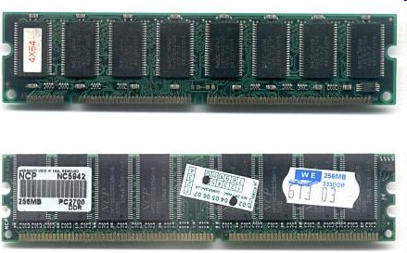
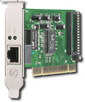
Kernel Device Structure
The System Call Interface
Process
Management
Memory Management
Filesystems
Device Control
Networking
Concurrency, multitasking
Virtual memory
Files and dirs: the VFS
TTYs and device access
Connectivity
Architecture
Dependent
Code
Memory Manager
File System Types
Device Control
Network Subsystem
Block Devices
IF drivers

Slide 16
Device Drivers
Device-specific code in the kernel that interacts directly with the device hardware
Supports a standard, internal interface
Same kernel I/O system can interact easily with different device drivers
Special device-specific configuration supported with the ioctl() system call
Device Drivers typically divided into two pieces:
Top half: accessed in call path from system calls
implements a set of standard, cross-device calls like open(), close(), read(), write(), ioctl() This is the kernel’s interface to the device driver
Top half will start I/O to device, may put thread to sleep until finished
Bottom half: run as interrupt routine
Gets input or transfers next block of output
May wake sleeping threads if I/O now complete

Slide 17
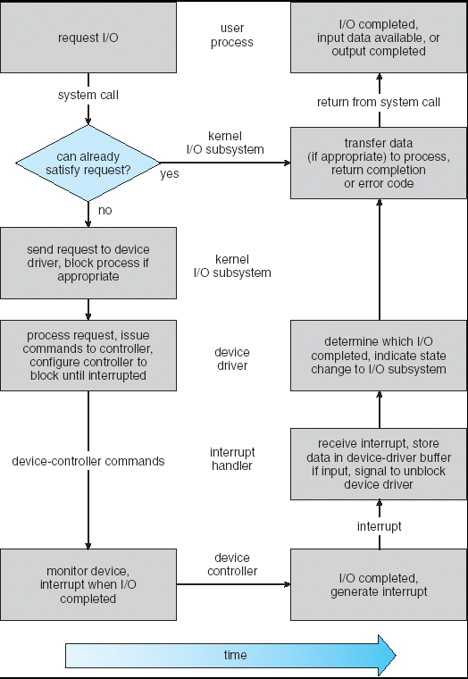
Recall: Life Cycle of an I/O Request
User
Program
Kernel I/O
Subsystem
Device Driver
Top Half
Device Driver
Bottom Half
Device
Hardware

Slide 18
The Goal of the I/O Subsystem
Provide Uniform Interfaces, Despite Wide Range of Different Devices
This code works on many different devices:
FILE fd = fopen("/dev/something", "rw"); for (int i = 0; i < 10; i++) { fprintf(fd, "Count %d\n", i); } close(fd);
Why? Because code that controls devices (“device driver”) implements standard interface
We will try to get a flavor for what is involved in actually controlling devices in rest of lecture
Can only scratch surface!

Slide 19
Want Standard Interface to Devices
Block Devices: e.g. disk drives, tape drives, DVD-ROM
Access blocks of data
Commands include open(), read(), write(), seek()
Raw I/O or file-system access
Memory-mapped file access possible
Character Devices: e.g. keyboards, mice, serial ports, some USB devices
Single characters at a time
May not be buffered like block devices
Libraries layered on top allow line editing
Network Devices: e.g. Ethernet, Wireless, Bluetooth
Different enough from block/character devices to have an extended interface
Unix and Windows include socket interface
Separates network protocol from network operation
Includes select() functionality
Usage: pipes, FIFOs, streams, queues, mailboxes

Slide 20
How Does User Deal with I/O Timing?
Blocking Interface: “Wait”
When request data (e.g. read syscall), put process to sleep until data is ready
When write data (e.g. write syscall), put process to sleep until device is ready for data
Non-blocking Interface: “Don’t Wait”
Returns quickly from read or write request with count of bytes successfully transferred
Read may return nothing, write may write nothing
Asynchronous Interface: “Tell Me Later”
When request data, take pointer to user’s buffer, return immediately; later kernel fills buffer and notifies user
When send data, take pointer to user’s buffer, return immediately; later kernel takes data and notifies user

Slide 21
Storage Devices

Slide 22
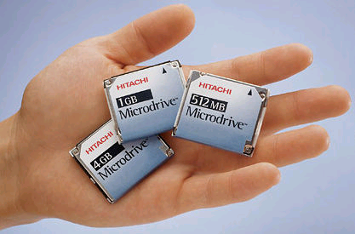
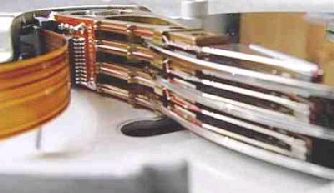
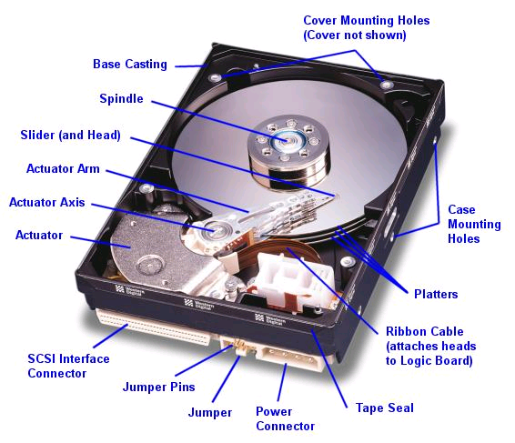
Hard Disk Drives (HDDs)
Read/Write Head
Side View
IBM/Hitachi Microdrive
IBM Personal Computer/AT (1986)
30 MB hard disk - $500
30-40ms seek time
0.7-1 MB/s (est.)
Western Digital Drive
http://www.storagereview.com/guide/

Slide 23
The Amazing Magnetic Disk
Unit of Transfer: Sector
Ring of sectors form a track
Stack of tracks form a cylinder
Heads position on cylinders
Disk Tracks ~ 1µm (micron) wide
Wavelength of light is ~ 0.5µm
Resolution of human eye: 50µm
100K tracks on a typical 2.5” disk
Separated by unused guard regions
Reduces likelihood neighboring tracks are corrupted during writes (still a small non-zero chance)

Slide 24
The Amazing Magnetic Disk
Track length varies across disk
Outside: More sectors per track, higher bandwidth
Disk is organized into regions of tracks with same # of sectors/track
Only outer half of radius is used
Most of the disk area in the outer regions of the disk
Disks so big that some companies (like Google) reportedly only use part of disk for active data
Rest is archival data

Slide 25
Shingled Magnetic Recording (SMR)
Overlapping tracks yields greater density, capacity
Restrictions on writing, complex DSP for reading

Slide 26
Magnetic Disks
Track
Sector
Cylinders: all the tracks under the head at a given point on all surfaces
Read/write data is a three-stage process:
Seek time: position the head/arm over the proper track
Rotational latency: wait for desired sector to rotate under r/w head
Transfer time: transfer a block of bits (sector) under r/w head
Head
Cylinder
Platter
Disk Latency = Queueing Time + Controller time +
Seek Time + Rotation Time + Xfer Time
Software
Queue
(Device Driver)
Hardware
Controller
Media Time
(Seek+Rot+Xfer)
Request
Result

Slide 27
Disk Performance Example
Assumptions:
Ignoring queuing and controller times for now
Avg seek time of 5ms,
7200RPM ⇒ Time for rotation: 60000 (ms/min) / 7200(rev/min) ~= 8ms
Transfer rate of 50MByte/s, block size of 4Kbyte ⇒ 4096 bytes/50×10⁶ (bytes/s) = 81.92 × 10⁻⁶ sec ≅ 0.082 ms for 1 sector
Read block from random place on disk:
Seek (5ms) + Rot. Delay (4ms) + Transfer (0.082ms) = 9.082ms
Approx. 9ms to fetch/put data: 4096 bytes/9.082×10⁻³ s ≅ 451KB/s
Read block from random place in same cylinder:
Rot. Delay (4ms) + Transfer (0.082ms) = 4.082ms
Approx. 4ms to fetch/put data: 4096 bytes/4.082×10⁻³ s ≅ 1.03MB/s
Read next block on same track:
Transfer (0.082ms): 4096 bytes/0.082×10⁻³ s ≅ 50MB/sec
Key to using disk effectively (especially for file systems) is to minimize seek and rotational delays

Slide 28
Lots of Intelligence in the Controller
Sectors contain sophisticated error correcting codes
Disk head magnet has a field wider than track
Hide corruptions due to neighboring track writes
Sector sparing
Remap bad sectors transparently to spare sectors on the same surface
Slip sparing
Remap all sectors (when there is a bad sector) to preserve sequential behavior
Track skewing
Sector numbers offset from one track to the next, to allow for disk head movement for sequential ops

Slide 29
Typical Numbers for Magnetic Disk
Parameter | Info/Range
Space/Density | Space: 14TB (Seagate), 8 platters, in 3½ inch form factor! Areal Density: ≥ 1 Terabit/square inch! (PMR, Helium, …)
Average Seek Time | Typically 4-6 milliseconds
Average Rotational Latency | Most laptop/desktop disks rotate at 3600-7200 RPM (16-8 ms/rotation). Server disks up to 15,000 RPM. Average latency is halfway around disk so 4-8 milliseconds
Controller Time | Depends on controller hardware
Transfer Time | Typically 50 to 250 MB/s. Depends on: Transfer size (usually a sector): 512B – 1KB per sector Rotation speed: 3600 RPM to 15000 RPM Recording density: bits per inch on a track Diameter: ranges from 1 in to 5.25 in
Cost | Used to drop by a factor of two every 1.5 years (or faster), now slowing down

Slide 30
Hard Drive Prices over Time

Slide 31
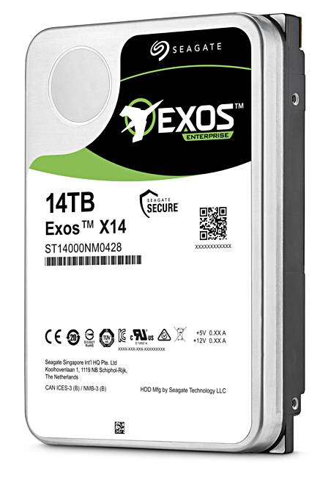
Example of Current HDDs
Seagate Exos X14 (2018)
14 TB hard disk
8 platters, 16 heads
Helium filled: reduce friction and power
4.16ms average seek time
4096 byte physical sectors
7200 RPMs
6 Gbps SATA /12Gbps SAS interface
261MB/s MAX transfer rate
Cache size: 256MB
Price: $615 (< $0.05/GB)
IBM Personal Computer/AT (1986)
30 MB hard disk
30-40ms seek time
0.7-1 MB/s (est.)
Price: $500 ($17K/GB, 340,000x more expensive !!)

Slide 32
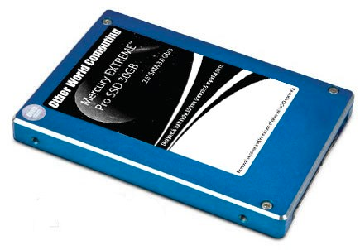
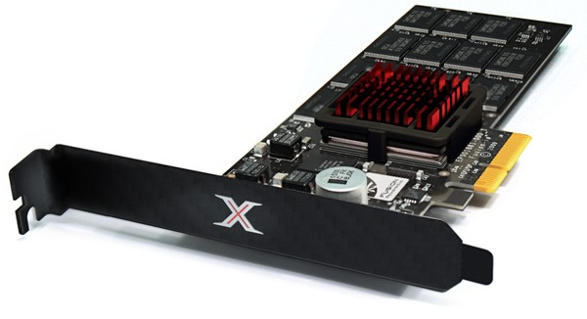
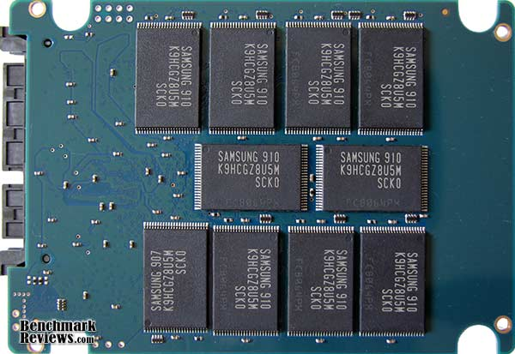
Solid State Disks (SSDs)
1995 – Replace rotating magnetic media with non-volatile memory (battery backed DRAM)
2009 – Use NAND Multi-Level Cell (2 or 3-bit/cell) flash memory
Sector (4 KB page) addressable, but stores 4-64 “pages” per memory block
Trapped electrons distinguish between 1 and 0
No moving parts (no rotate/seek motors)
Eliminates seek and rotational delay (0.1-0.2ms access time)
Very low power and lightweight
Limited “write cycles”
Rapid advances in capacity and cost ever since!

Slide 33
SSD Architecture – Reads
NAND
NAND
NAND
NAND
NAND
NAND
NAND
NAND
Read 4 KB Page: ~25 usec
No seek or rotational latency
Transfer time: transfer a 4KB page
SATA: 300-600MB/s => ~4 x10³ b / 400 x 10⁶ bps => 10 us
Latency = Queuing Time + Controller time + Xfer Time
Highest Bandwidth: Sequential OR Random reads
Host
Buffer
Manager
(software
Queue)
Flash
Memory
Controller
NAND
NAND
NAND
NAND
SATA
NAND
NAND
NAND
NAND
NAND
NAND
NAND
NAND
DRAM
NAND
NAND
NAND
NAND
NAND
NAND
NAND
NAND
NAND
NAND
NAND
NAND

Slide 34
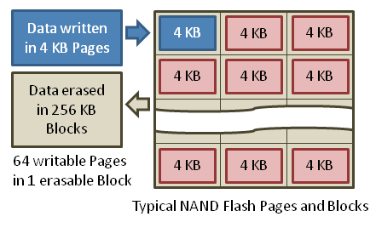
SSD Architecture – Writes
Writing data is complex! (~200μs – 1.7ms )
Can only write to empty pages in a block
Erasing a block takes ~1.5ms
Controller maintains pool of empty blocks by coalescing used pages (read, erase, write), also reserves some % of capacity
Rule of thumb:
writes 10x slower than reads
erasure 10x slower than writes
https://en.wikipedia.org/wiki/Solid-state_drive

Slide 35
SSD Architecture – Writes
SSDs provide same interface as HDDs to OS – read and write chunk (4KB) at a time
But can only overwrite data 256KB at a time!
Why not just erase and rewrite new version of entire 256KB block?
Erasure is very slow (milliseconds)
Each block has a finite lifetime, can only be erased and rewritten about 10K times
Heavily used blocks likely to wear out quickly

Slide 36
Solution – Two Systems Principles
Layer of Indirection
Maintain a Flash Translation Layer (FTL) in SSD
Map virtual block numbers (which OS uses) to physical page numbers (which flash mem. controller uses)
Can now freely relocate data w/o OS knowing
Copy on Write
Don’t overwrite a page when OS updates its data
Instead, write new version in a free page
Update FTL mapping to point to new location

Slide 37
Flash Translation Layer
No need to erase and rewrite entire 256KB block when making small modifications
SSD controller can assign mappings to spread workload across pages
Wear Levelling
What to do with old versions of pages?
Garbage Collection in background
Erase blocks with old pages, add to free list

Slide 38
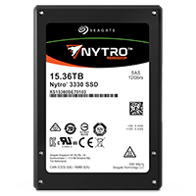
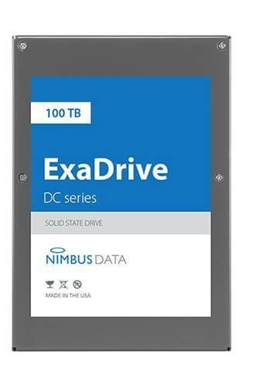
Some “Current” 3.5in SSDs
Seagate Nytro SSD: 15TB (2017)
Dual 12Gb/s interface
Seq reads 860MB/s
Seq writes 920MB/s
Random Reads (IOPS): 102K
Random Writes (IOPS): 15K
Price (Amazon): $6325 ($0.41/GB)
Nimbus SSD: 100TB (2019)
Dual port: 12Gb/s interface
Seq reads/writes: 500MB/s
Random Read Ops (IOPS): 100K
Unlimited writes for 5 years!
Price: ~ $50K? ($0.50/GB)

Slide 39
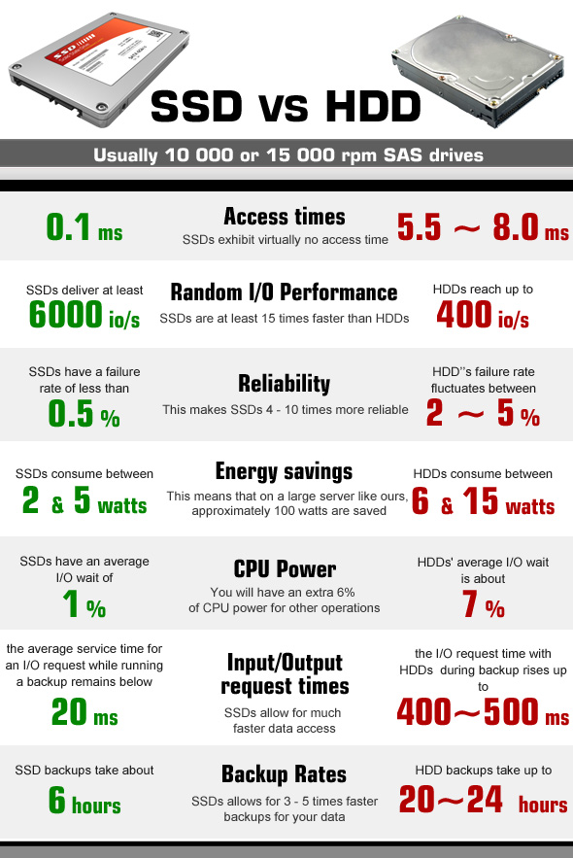
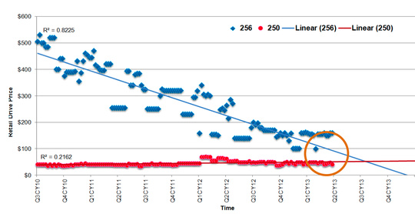
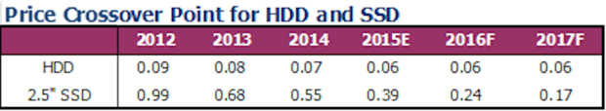
HDD vs. SSD Comparison
SSD prices drop much faster than HDD

Slide 40
SSD Summary
Pros (vs. hard disk drives):
Low latency, high throughput (eliminate seek/rotational delay)
No moving parts:
Very light weight, low power, silent, very shock insensitive
Read at memory speeds (limited by controller and I/O bus)
Cons
Small storage (0.1-0.5x disk)
Hybrid alternative: combine small SSD with large HDD
Asymmetric block write performance: read pg/erase/write pg
Controller garbage collection (GC) algorithms have major effect on performance
Limited drive lifetime
1-10K writes/page for MLC NAND
Avg failure rate is 6 years, life expectancy is 9–11 years
These are changing rapidly!

Slide 41
A Bit of I/O Performance

Slide 42
Recall: Times (s) and Rates (op/s)
Latency – time to complete a task
Measured in units of time (s, ms, us, …, hours, years)
Response Time - time to initiate and operation and get its response
Able to issue one that depends on the result
Know that it is done (anti-dependence, resource usage)
Throughput or Bandwidth – rate at which tasks are performed
Measured in units of things per unit time (ops/s, GLOP/s)
Performance???
Operation time (4 mins to run a mile…)
Rate (mph, mpg, …)

Slide 43
Basic Performance Concepts
Response Time or Latency: Time to perform an operation(s)
Bandwidth or Throughput: Rate at which operations are performed (op/s)
Files: MB/s, Networks: Mb/s, Arithmetic: GFLOP/s
Start up or “Overhead”: time to initiate an operation
Most I/O operations are roughly linear in b bytes
Latency(b) = Overhead + b/TransferCapacity

Slide 44
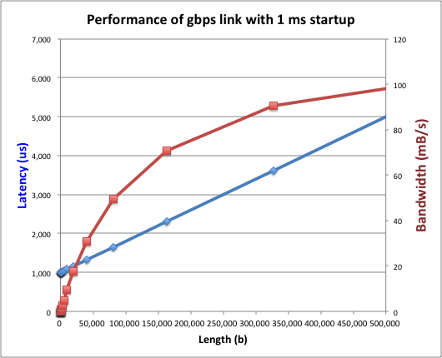
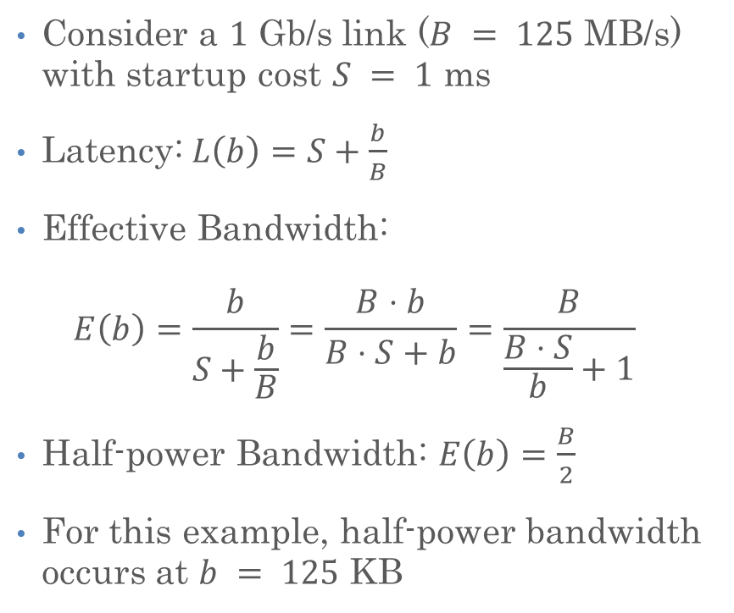
Example (Fast Network)
Consider a $1 \text{Gb}\text{/}\text{s}$ link ($B = 125 \text{MB}\text{/}\text{s}$) with startup cost $S = 1 \text{ms}$
Latency:$L\left(b\right)=S+\frac{b}{B}$
Effective Bandwidth: $E\left(b\right)=\frac{b}{S+\frac{b}{B}}=\frac{B⋅b}{B⋅S+b}=\frac{B}{\frac{B⋅S}{b}+1}$
Half-power Bandwidth: $E\left(b\right)=\frac{B}{2}$
For this example, half-power bandwidth occurs at $b = 125 \text{KB}$

Slide 45
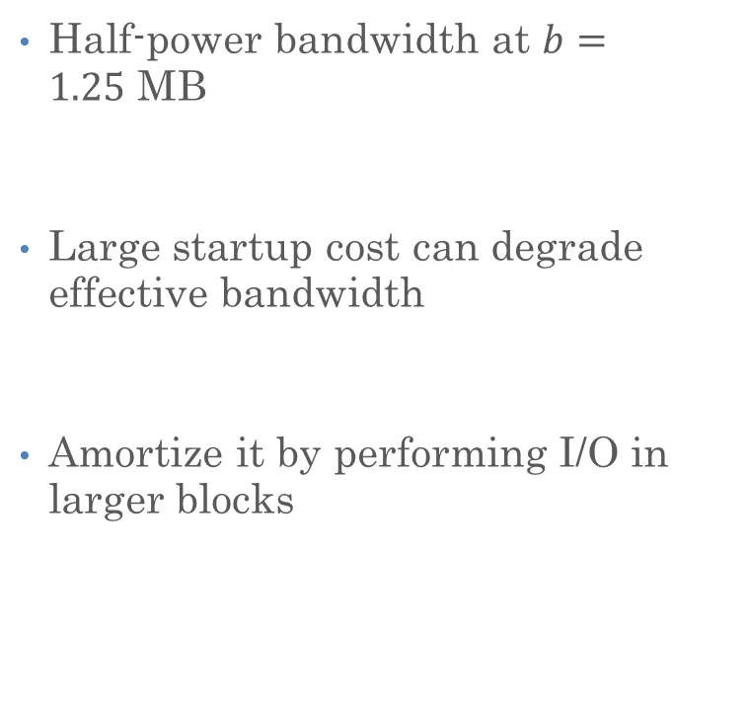
Example: 10 ms Startup Cost (e.g., Disk)
Half-power bandwidth at $b=1.25 \text{MB}$
Large startup cost can degrade effective bandwidth
Amortize it by performing I/O in larger blocks
Half-power b = 1,250,000 bytes!

Slide 46
What Determines Peak BW for I/O?
Bus Speed
PCI-X: 1064 MB/s = 133 MHz x 64 bit (per lane)
ULTRA WIDE SCSI: 40 MB/s
Serial Attached SCSI & Serial ATA & IEEE 1394 (firewire): 1.6 Gb/s full duplex (200 MB/s)
USB 3.0 – 5 Gb/s
Thunderbolt 3 – 40 Gb/s
Device Transfer Bandwidth
Rotational speed of disk
Write / Read rate of NAND flash
Signaling rate of network link
Whatever is the bottleneck in the path…

Slide 47
Overall I/O performance
Controller
Performance of I/O subsystem
Metrics: Response Time, Throughput
Effective BW = transfer size / response time
Contributing factors to latency:
Software paths (can be loosely modeled by a queue)
Hardware controller
I/O device service time
Queuing behavior:
Can lead to big increases of latency as utilization increases
User
Thread
I/O
device
Queue
[OS Paths]
Response Time = Queue + I/O device service time
300
Response
Time (ms)
200
100
0
0%
100%
Throughput (Utilization)
(% total BW)

Slide 48
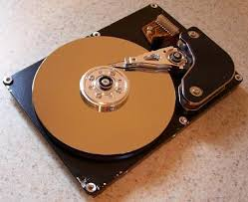
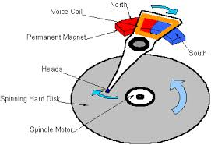
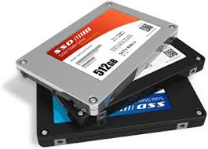

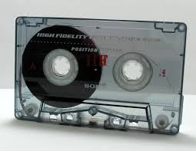
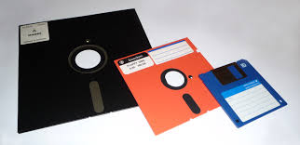
Recall: I/O and Storage Layers
Application / Service
High Level I/O
Streams
Low Level I/O
File Descriptors
What we covered before
Syscall
open(), read(), write(), close(), …
File System
Files/Directories/Indexes
What we will
cover next…
I/O Driver
Commands and Data Transfers
Disks, Flash, Controllers, DMA
What we just
covered…

Slide 49
From Storage to File Systems
I/O API and
syscalls
Variable-Size Buffer
Memory Address
Logical Index, Typically 4 KB
File System
Block
Flash Trans. Layer
Hardware Devices
Sector(s)
Sector(s)
Sector(s)
Phys. Block
Phys Index., 4KB
Physical Index,
512B or 4KB
Erasure Page
HDD
SSD

Slide 50
Building a File System
Classic OS situation
Take limited hardware interface (array of blocks) and provide a more convenient/useful interface with:
Naming: Find file by name, not block numbers
Organize file names with directories
Organization: Map files to blocks
Protection: Enforce access restrictions
Reliability: Keep files intact despite crashes, hardware failures, etc.

Slide 51

Translation from User to System View
File (Bytes)
File
System
What happens if user says: “give me bytes 2 – 12?”
Fetch block corresponding to those bytes
Return just the correct portion of the block
What about writing bytes 2 – 12?
Fetch block, modify relevant portion, write out block
Everything inside file system is in terms of whole-size blocks
Actual disk I/O happens in blocks
read/write smaller than block size needs to translate and buffer

Slide 52
Disk Management
The disk is accessed as a linear array of sectors.
How to identify a sector?
Physical position
Sector is a vector [cylinder, surface, sector]
Not used anymore
OS/BIOS must deal with bad sectors
Logical Block Addressing (LBA)
Every sector has an integer address
Controller translates from address to physical position
Shields OS from disk structure

Slide 53
What Does the File System Need?
Track free disk blocks
Need to know where to put newly written data
Track which blocks contain data for which files
Need to know where to read a file from
Track files in a directory
Find list of file's blocks given its name
Where do we maintain all of this?
Somewhere on disk

Slide 54
Data Structures on Disk
Bit different than data structures in memory
Access a block at a time
Can't efficiently read/write a single word
Have to read/write full block containing it
Ideally want sequential access patterns
Durability
Ideally, file system is in meaningful state upon shutdown
This obviously isn't always the case…

Slide 55
Critical Factors in File System Design
(Hard) Disks Performance !!!
Maximize sequential access, minimize seeks
Open before Read/Write
Can perform protection checks and look up where the actual file resource are, in advance
Size is determined as they are used !!!
Can write (or read zeros) to expand the file
Start small and grow, need to make room
Organized into directories
What data structure (on disk) for that?
Need to carefully allocate / free blocks
Such that access remains efficient

Slide 56
FAT: File Allocation Table
MS-DOS, 1977
Still widely used!

Slide 57
FAT (File Allocation Table)
FAT
Disk Blocks
0:
0:
Assume (for now) we have a way to translate a path to a “file number”
i.e., a directory structure
Disk Storage is a collection of Blocks
Just hold file data (offset o = <B, x>)
Example: file_read 31, <2, x>
Index into FAT with file number
Follow linked list to block
Read the block from disk into memory
File number
31:
File 31, Block 0
File 31, Block 1
File 31, Block 2
N-1:
N-1:
memory

Slide 58
FAT (File Allocation Table)
FAT
Disk Blocks
0:
0:
File is a collection of disk blocks
FAT is linked list 1-1 with blocks
File number is index of root of block list for the file
File offset: block number and offset within block
Follow list to get block number
Unused blocks marked free
Could require scan to find
Or, could use a free list
File number
31:
File 31, Block 0
File 31, Block 1
free
File 31, Block 2
N-1:
N-1:
memory

Slide 59
FAT (File Allocation Table)
FAT
Disk Blocks
Where is FAT stored?
On disk
How to format a disk?
Zero the blocks, mark FAT entries “free”
How to quick format a disk?
Mark FAT entries “free”
Simple: can be implemented in device firmware
0:
0:
File 1 number
31:
File 31, Block 0
File 31, Block 1
File 31, Block 3
free
File 2 number
File 31, Block 2
N-1:
N-1:
memory

Slide 60
How to get the File Number?
Look up in directory structure
A directory is a file containing <file_name : file_number> mappings
File number could be a file or another directory
Operating system stores the mapping in the directory in a format it interprets
Each <file_name : file_number> mapping is called a directory entry
Process isn’t allowed to read the raw bytes of a directory
The read function doesn’t work on a directory
Instead, see readdir, which iterates over the map without revealing the raw bytes
Why shouldn’t the OS let processes read/write the bytes of a directory?

Slide 61
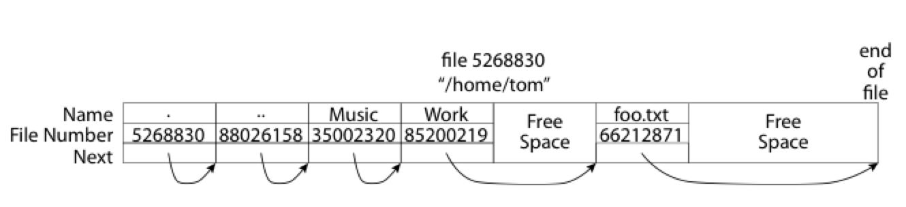
FAT: Directories
A directory is a file containing <file_name: file_number> mappings
Free space for new entries
In FAT: file attributes are kept in directory (!!!)
Each directory a linked list of entries
Where do you find root directory (“/”)?

Slide 62
FAT Directory Structure
How many disk accesses to resolve “/my/book/count”?
Read in file header for root (fixed spot on disk)
Read in first data block for root
Table of file name/index pairs. Search linearly – ok since directories typically very small
Read in file header for “my”
Read in first data block for “my”; search for “book”
Read in file header for “book”
Read in first data block for “book”; search for “count”
Read in file header for “count”
Current working directory: Per-address-space pointer to a directory used for resolving file names
Allows user to specify relative filename instead of absolute path (say CWD=“/my/book” can resolve “count”)

Slide 63
Many Huge FAT Security Holes!
FAT has no access rights
FAT has no header in the file blocks
Just gives an index into the FAT
(file number = block number)

Slide 64
Conclusion: I/O Devices
I/O Devices Types:
Many different speeds (0.1 bytes/sec to GBytes/sec)
Different Access Patterns:
Block Devices, Character Devices, Network Devices
Different Access Timing:
Blocking, Non-blocking, Asynchronous
I/O Controllers: Hardware that controls actual device
Processor Accesses through I/O instructions, load/store to special physical memory
Notification mechanisms
Interrupts
Polling: Report results through status register that processor looks at periodically
Device drivers interface to I/O devices
Provide clean Read/Write interface to OS above
Manipulate devices through PIO, DMA & interrupt handling
Three types: block, character, and network

Slide 65
Conclusion: Storage Devices
Disk Performance:
Queuing time + Controller + Seek + Rotational + Transfer
Rotational latency: on average ½ rotation
Transfer time: spec of disk depends on rotation speed and bit storage density
Devices have complex interaction and performance characteristics
Response time (Latency) = Queue + Overhead + Transfer
Effective BW = BW * T/(S+T)
HDD: Queuing time + controller + seek + rotation + transfer
SDD: Queuing time + controller + transfer (erasure & wear)
Systems (e.g., file system) designed to optimize performance and reliability
Relative to performance characteristics of underlying device
Bursts & High Utilization introduce queuing delays

Slide 66
Conclusion: File Systems
File System:
Transforms blocks into Files and Directories
Optimize for size, access and usage patterns
Maximize sequential access, allow efficient random access
Projects the OS protection and security regime (UGO vs ACL)
Naming: translating from user-visible names to actual sys resources
Directories provide naming for local file systems
Linked or tree structure stored in files
Components: directory, index, storage blocks, free list
File Allocation Table (FAT) – simple and primitive
I-number = FAT index, FAT 1-1 with disk blocks, file is singly-link list of FAT=Blocks, directory is essentially file of <name, index, attributes> at known location
Linear search – for block, for i-number

Slide 67
